Slide 1



COMPUTER GRAPHICS & MULTIMEDIA SYSTEMS SCS1302
UNIT III – PART II

Slide 2
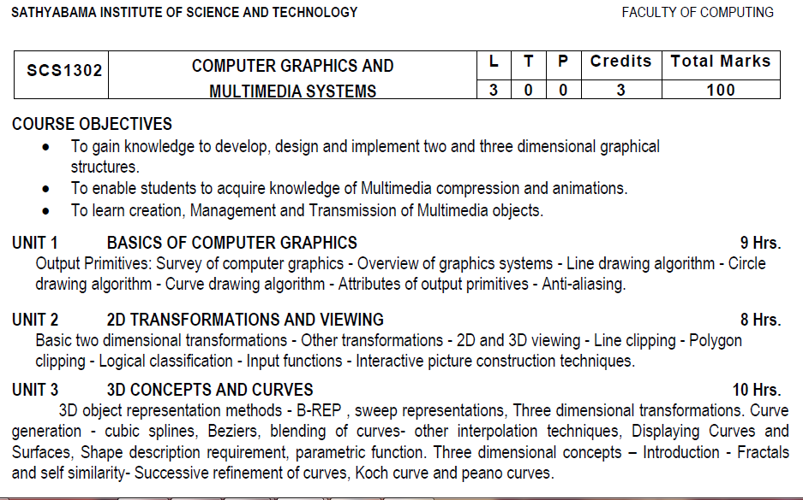
Syllabus

Slide 3
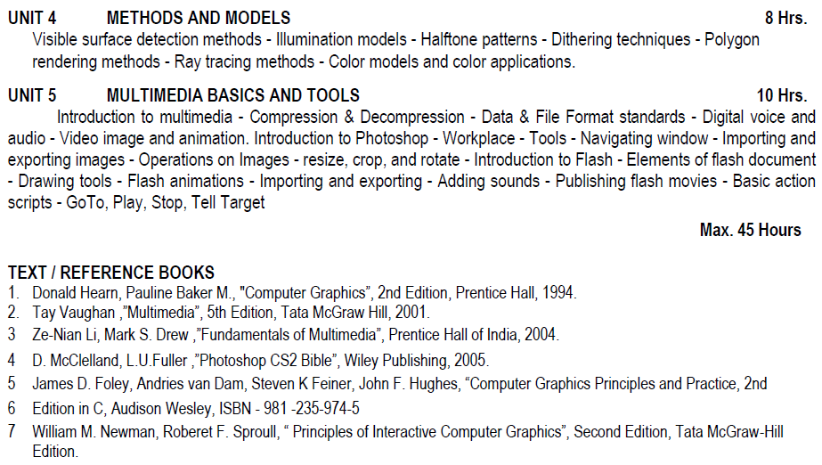
Syllabus

Slide 4
Course Objective(CO)
CO1: Construct lines and circles for the given input.
CO2: Apply 2D transformation techniques to transform the shapes to fit them as per the picture definition.
CO3: Construct splines, curves and perform 3D transformations
CO4: Apply colour and transformation techniques for various applications.
CO5: Analyse the fundamentals of animation, virtual reality, and underlying technologies.
CO6: Develop photo shop applications

Slide 5
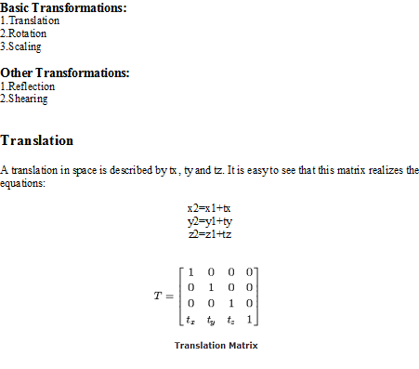
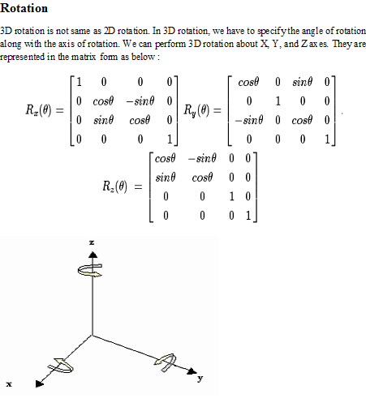
Three dimensional transformations

Slide 6
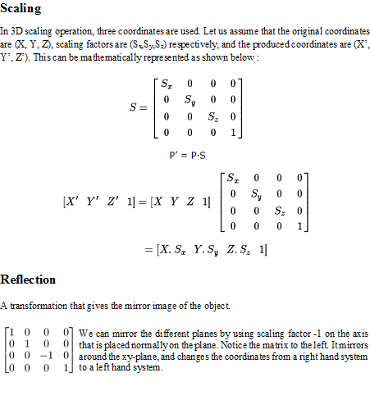
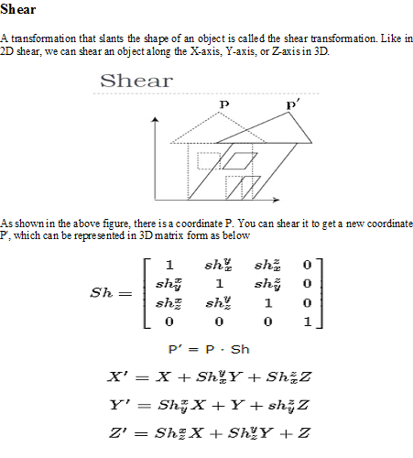
Three dimensional transformations

Slide 7
Translation - Example
Given a 3D object with coordinate points A(0, 3, 1), B(3, 3, 2), C(3, 0, 0), D(0, 0, 0). Apply the translation with the distance 1 towards X axis, 1 towards Y axis and 2 towards Z axis and obtain the new coordinates of the object.
Given-
Old coordinates of the object = A (0, 3, 1), B(3, 3, 2), C(3, 0, 0), D(0, 0, 0)
Translation vector = (T_{x}, T_{y}, T_{z}) = (1, 1, 2)
For Coordinates A(0, 3, 1)
Let the new coordinates of A = (X’, Y’, Z’).
Applying the translation equations, we have-
X’ = X + T_{x} = 0 + 1 = 1
Y’ = Y + T_{y} = 3 + 1 = 4
Z’ = Z + T_{z} = 1 + 2 = 3
Thus, New coordinates of A = (1, 4, 3).

Slide 8
Translation - Example
For Coordinates B(3, 3, 2)
Let the new coordinates of B = (X’, Y’, Z’).
Applying the translation equations, we have-
X’ = X + T_{x} = 3 + 1 = 4
Y’ = Y + T_{y} = 3 + 1 = 4
Z’ = Z + T_{z} = 2 + 2 = 4
Thus, New coordinates of B = (4, 4, 4).
For Coordinates C(3, 0, 0)
Let the new coordinates of C = ((X’, Y’, Z’).
Applying the translation equations, we have-
X’ = X + T_{x} = 3 + 1 = 4
Y’ = Y + T_{y} = 0 + 1 = 1
Z’ = Z + T_{z} = 0 + 2 = 2
Thus, New coordinates of C = (4, 1, 2).

Slide 9
Translation - Example
For Coordinates D(0, 0, 0)
Let the new coordinates of D = (X’, Y’, Z’).
Applying the translation equations, we have-
X’ = X + T_{x} = 0 + 1 = 1
Y’ = Y + T_{y} = 0 + 1 = 1
Z’ = Z + T_{z} = 0 + 2 = 2
Thus, New coordinates of D = (1, 1, 2).
Thus, New coordinates of the object = A (1, 4, 3), B(4, 4, 4), C(4, 1, 2), D(1, 1, 2).

Slide 10
Rotation - Example
Given a homogeneous point (1, 2, 3). Apply rotation 90 degree towards X, Y and Z axis and find out the new coordinate points.
Solution-
Given-
Old coordinates = (X, Y, Z) = (1, 2, 3)
Rotation angle = θ = 90º

Slide 11
For X-Axis Rotation-
This rotation is achieved by using the following rotation equations-
X’ = X
Y’ = Y cosθ – Z sinθ
Z’ = Y sinθ + Z cosθ
For Y-Axis Rotation-
This rotation is achieved by using the following rotation equations-
X’ = Z sinθ + X cosθ
Y’ = Y
Z’ = Y cosθ – X sinθ
For Z-Axis Rotation-
This rotation is achieved by using the following rotation equations-
X’ = X cosθ – Y sinθ
Y’ = X sinθ + Y cosθ
Z’ = Z

Slide 12
Rotation - Example
For X-Axis Rotation-
Let the new coordinates after rotation = (X’, Y’, Z’).
Applying the rotation equations, we have-
X’ = X = 1
Y’ = Y cosθ – Z sinθ
= 2 cos90° – 3 sin90°
= 2 x 0 – 3 x 1 = -3
Z’ = Y sinθ + Z cosθ
= 2 sin90° + 3 cos90°
= 2 x 1 + 3 x 0 = 2
Thus, New coordinates after rotation = (1, -3, 2).
For Y-Axis Rotation-
Let the new coordinates after rotation = (X’, Y’, Z’).
Applying the rotation equations, we have-
X’ = Z sinθ + X cosθ
= 3 sin90° + 1 cos90°
= 3 x 1 + 1 x 0 = 3
Y’ = Y = 2
Z’ = Y cosθ – X sinθ
= 2 x cos90° – 1 x sin90°
= 2 x 0 – 1 x 1 = -1
Thus, New coordinates after rotation = (3, 2, -1).

Slide 13
Rotation - Example
For Z-Axis Rotation-
Let the new coordinates after rotation = (X’, Y’, Z’).
Applying the rotation equations, we have-
X’ = X cosθ – Y sinθ
= 1 x cos90° – 2 x sin90°
= 1 x 0 – 2 x 1 = -2
Y’= X sinθ + Y cosθ
= 1 x sin90° + 2 x cos90°
= 1 x 1 + 2 x 0 = 1
Z’= Z= 3
Thus, New coordinates after rotation = (-2, 1, 3).

Slide 14
Scaling
Consider a point object O has to be scaled in a 3D plane.
Let-
Initial coordinates of the object O = (X, Y,Z)
Scaling factor for X-axis = S_{x}
Scaling factor for Y-axis = S_{y}
Scaling factor for Z-axis = S_{z}
New coordinates of the object O after scaling = (X’, Y’, Z’)
This scaling is achieved by using the following scaling equations-
X’ = X x S_{x}
Y’ = Y x S_{y}
Z’ = Z x S_{z}

Slide 15
Scaling - Example
Given a 3D object with coordinate points A(0, 3, 3), B(3, 3, 6), C(3, 0, 1), D(0, 0, 0). Apply the scaling parameter 2 towards X axis, 3 towards Y axis and 3 towards Z axis and obtain the new coordinates of the object.
Solution-
Given-
Old coordinates of the object = A (0, 3, 3), B(3, 3, 6), C(3, 0, 1), D(0, 0, 0)
Scaling factor along X axis = 2
Scaling factor along Y axis = 3
Scaling factor along Z axis = 3

Slide 16
Scaling - Example
For Coordinates A(0, 3, 3)
Let the new coordinates of A after scaling = (X’, Y’, Z’).
Applying the scaling equations, we have-
X’ = X x S_{x} = 0 x 2 = 0
Y’ = Y x S_{y} = 3 x 3 = 9
Z’ = Z x S_{z} = 3 x 3 = 9
Thus, New coordinates of corner A after scaling = (0, 9, 9).
For Coordinates B(3, 3, 6)
Let the new coordinates of B after scaling = (X’, Y’, Z’).
Applying the scaling equations, we have-
X’ = X x S_{x} = 3 x 2 = 6
Y’ = Y x S_{y} = 3 x 3 = 9
Z’ = Z x S_{z} = 6 x 3 = 18
Thus, New coordinates of corner B after scaling = (6, 9, 18).

Slide 17
Scaling - Example
For Coordinates C(3, 0, 1)
Let the new coordinates of C after scaling = (X’, Y’, Z’).
Applying the scaling equations, we have-
X’ = X x S_{x} = 3 x 2 = 6
Y’ = Y x S_{y} = 0 x 3 = 0
Z’ = Z x S_{z} = 1 x 3 = 3
Thus, New coordinates of corner C after scaling = (6, 0, 3).
For Coordinates D(0, 0, 0)
Let the new coordinates of D after scaling = (X’, Y’, Z’).
Applying the scaling equations, we have-
X’ = X x S_{x} = 0 x 2 = 0
Y’ = Y x S_{y} = 0 x 3 = 0
Z’ = Z x S_{z} = 0 x 3 = 0
Thus, New coordinates of corner D after scaling = (0, 0, 0).

Slide 18
Reflection - Example
Reflection relative to XY plane
Reflection relative to YZ plane
Reflection relative to XZ plane
Reflection Relative to XY Plane:
This reflection is achieved by using the following reflection equations-
X’ = X
Y’ = Y
Z’ = -Z
Reflection Relative to YZ Plane:
This reflection is achieved by using the following reflection equations-
X’ = -X
Y’ = Y
Z’ = Z
Reflection Relative to XZ Plane:
This reflection is achieved by using the following reflection equations-
X’ = X
Y’ = -Y
Z’ = Z

Slide 19
Reflection - Example
Given a 3D triangle with coordinate points A(3, 4, 1), B(6, 4, 2), C(5, 6, 3). Apply the reflection on the XY plane and find out the new coordinates of the object.
Solution
Given:
Coordinates of the triangle = A (3, 4, 1), B(6, 4, 2), C(5, 6, 3)
Reflection has to be taken on the XY plane
For Coordinates A(3, 4, 1)
Let the new coordinates of corner A after reflection = (X’, Y’, Z’).
Applying the reflection equations, we have-
X’ = X = 3
Y’ = Y = 4
Z’ = -Z = -1
Thus, New coordinates of corner A after reflection = (3, 4, -1).

Slide 20
Reflection - Example
For Coordinates B(6, 4, 2)
Let the new coordinates of corner B after reflection = (X’, Y’, Z’).
Applying the reflection equations, we have-
X’ = X = 6
Y’ = Y = 4
Z’ = -Z = -2
Thus, New coordinates of corner B after reflection = (6, 4, -2).
For Coordinates C(5, 6, 3)
Let the new coordinates of corner C after reflection = (X’, Y’, Z’).
Applying the reflection equations, we have-
X’ = X = 5
Y’ = Y = 6
Z’ = -Z = -3
Thus, New coordinates of corner C after reflection = (5, 6, -3).
Thus, New coordinates of the triangle after reflection = A (3, 4, -1), B(6, 4, -2), C(5, 6, -3).

Slide 21
Shearing - Example
Shearing parameter towards X direction = Sh_{x}
Shearing parameter towards Y direction = Sh_{y}
Shearing parameter towards Z direction = Sh_{z}
Shearing in X Axis-
Shearing in X axis is achieved by using the following shearing equations-
X’ = X
Y’ = Y + Sh_{y} x X
Z’ = Z + Sh_{z} x X
Shearing in Y Axis-
Shearing in Y axis is achieved by using the following shearing equations-
X’ = X + Sh_{x} x Y
Y’ = Y
Z’ = Z + Sh_{z} x Y
Shearing in Z Axis-
Shearing in Z axis is achieved by using the following shearing equations-
X’ = X + Sh_{x} x Z
Y’ = Y + Sh_{y} x Z
Z’ = Z

Slide 22
Shearing - Example
Given a 3D triangle with points (0, 0, 0), (1, 1, 2) and (1, 1, 3). Apply shear parameter 2 on X axis, 2 on Y axis and 3 on Z axis and find out the new coordinates of the object.
Solution-
Given-
Old corner coordinates of the triangle = A (0, 0, 0), B(1, 1, 2), C(1, 1, 3)
Sh_{x} = 2
Sh_{y} = 2
Sh_{z} = 3
Shearing in X Axis-
For Coordinates A(0, 0, 0)
Let the new coordinates of corner A after shearing = (X’, Y’, Z’).
Applying the shearing equations, we have-
X’ = X = 0
Y’ = Y + Sh_{y} x X = 0 + 2 x 0 = 0
Z = Z + Sh_{z} x X = 0 + 3 x 0 = 0
Thus, New coordinates of corner A after shearing = (0, 0, 0).

Slide 23
Shearing - Example
For Coordinates B(1, 1, 2)
Let the new coordinates of corner B after shearing = (X’, Y’, Z’).
Applying the shearing equations, we have-
X’ = X = 1
Y’ = Y + Sh_{y} x X = 1 + 2 x 1 = 3
Z’ = Z + Sh_{z} x X = 2 + 3 x 1 = 5
Thus, New coordinates of corner B after shearing = (1, 3, 5).
For Coordinates C(1, 1, 3)
Let the new coordinates of corner C after shearing = (X’, Y’, Z’).
Applying the shearing equations, we have-
X’ = X = 1
Y’ = Y + Sh_{y} x X = 1 + 2 x 1 = 3
Z’ = Z + Sh_{z} x X = 3 + 3 x 1 = 6
Thus, New coordinates of corner C after shearing = (1, 3, 6).
Thus, New coordinates of the triangle after shearing in X axis = A (0, 0, 0), B(1, 3, 5), C(1, 3, 6).

Slide 24
Curve generation – Beziers Curves– B Spline Curves

Slide 25
Types of Curves
A curve is an infinitely large set of points. Each point has two neighbors except endpoints. Curves can be broadly classified into three categories − explicit, implicit, and parametric curves.
Implicit Curves
Implicit curve representations define the set of points on a curve by employing a procedure that can test to see if a point in on the curve. Usually, an implicit curve is defined by an implicit function of the form −
f(x, y) = 0
It can represent multivalued curves (multiple y values for an x value). A common example is the circle, whose implicit representation is
x² + y² - R² = 0

Slide 26
Types of Curves
2. Explicit Curves
A mathematical function y = f(x) can be plotted as a curve. Such a function is the explicit representation of the curve. The explicit representation is not general, since it cannot represent vertical lines and is also single-valued. For each value of x, only a single value of y is normally computed by the function.
3. Parametric Curves
Curves having parametric form are called parametric curves. The explicit and implicit curve representations can be used only when the function is known. In practice the parametric curves are used. A two-dimensional parametric curve has the following form −
P(t) = f(t), g(t) or P(t) = x(t), y(t)
The functions f and g become the (x, y) coordinates of any point on the curve, and the points are obtained when the parameter t is varied over a certain interval [a, b], normally [0, 1].

Slide 27
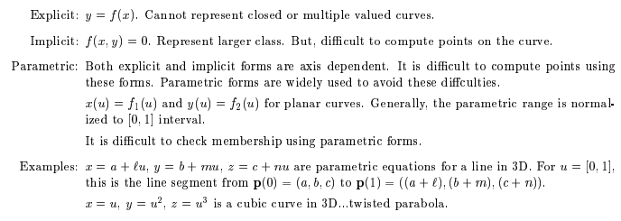
Types of Curves

Slide 28
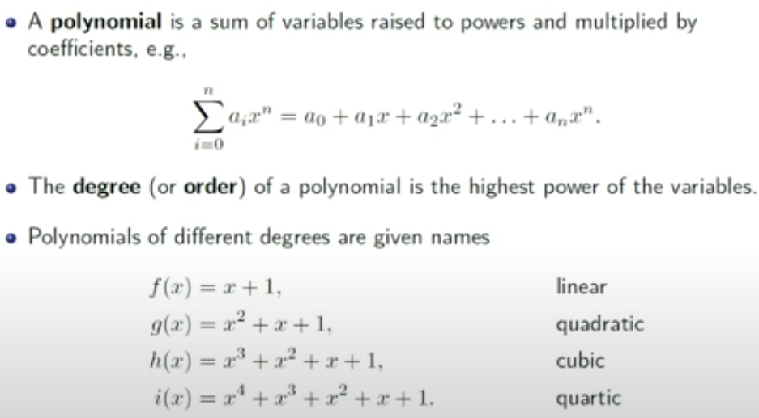
BEZIER CURVES

Slide 29
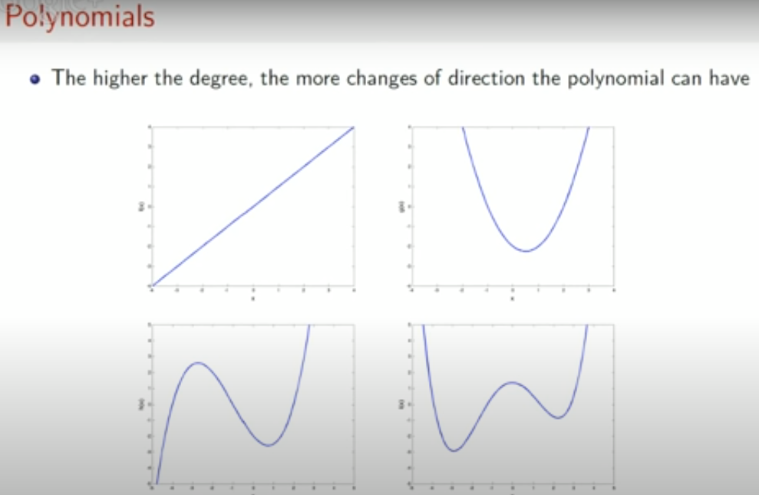
BEZIER CURVES

Slide 30
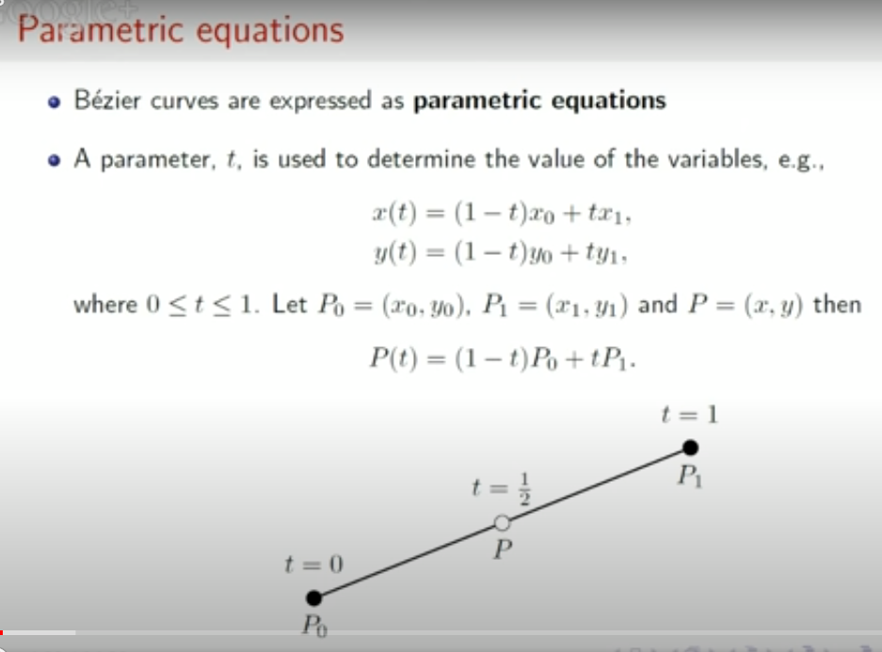

Slide 31
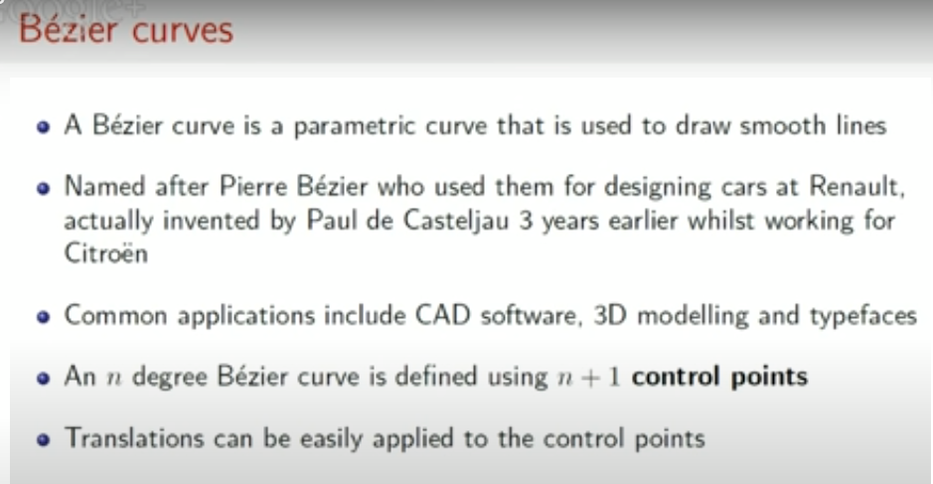

Slide 32
Bezier Curve
The concept of bezier curves was given by Pierre Bezier.
Bezier Curve may be defined as-
Bezier are ends of the curve.
Other Curve is parametric curve defined by a set of control points.
Two points points determine the shape of the curve.

Slide 33
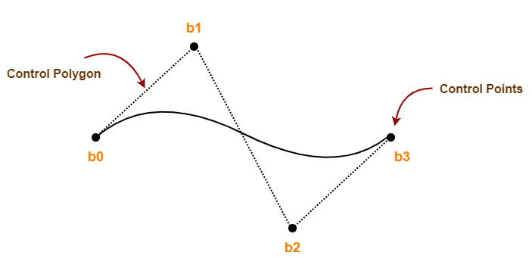
Example of a Bezier Curve
Here,
This bezier curve is defined by a set of control points b₀, b₁, b₂ and b₃.
Points b₀ and b₃ are ends of the curve.
Points b₁ and b₂ determine the shape of the curve.

Slide 34
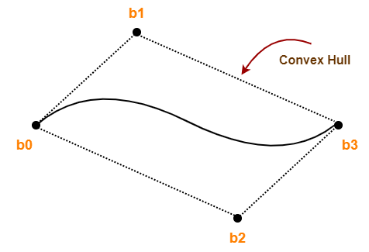
Bezier Curve Properties
Bezier curve is always contained within a polygon called as convex hull of its control points.
Bezier curve generally follows the shape of its defining polygon.
The first and last points of the curve are coincident with the first and last points of the defining polygon.
The degree of the polynomial defining the curve segment is one less than the total number of control points.
Degree = Num of Control Points – 1

Slide 35
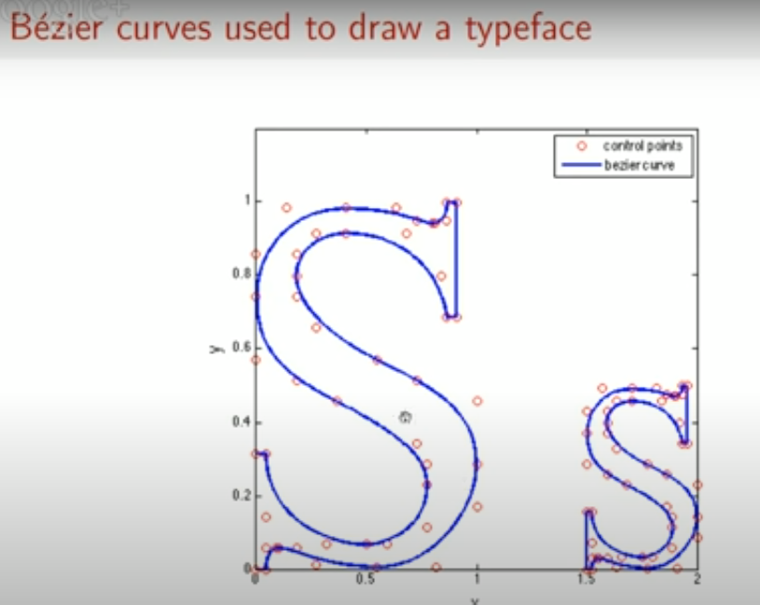

Slide 36
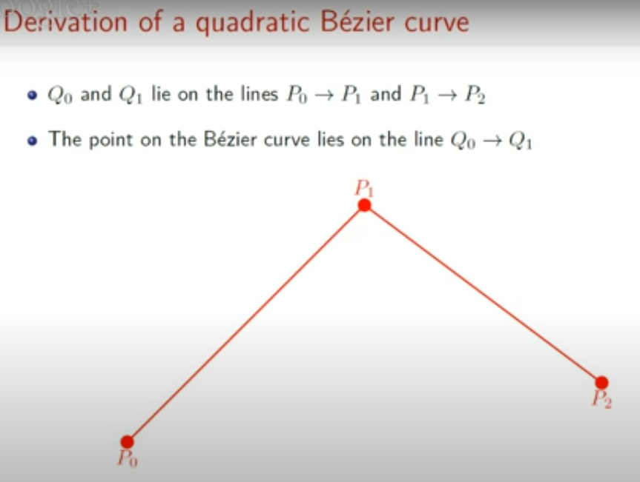

Slide 37
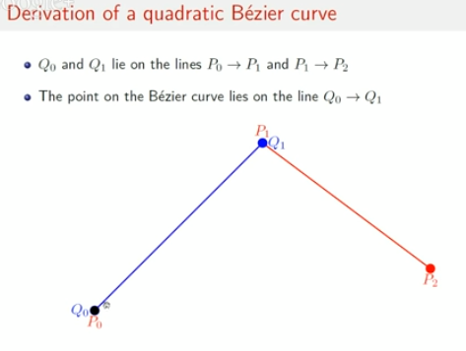
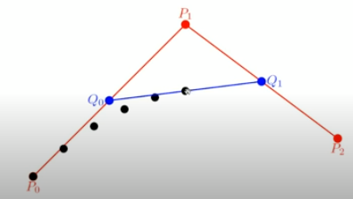
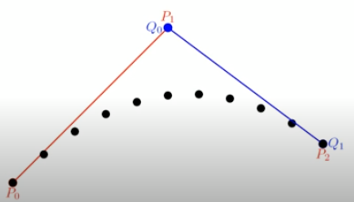
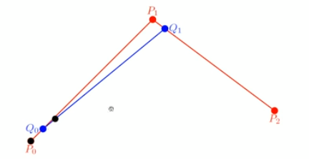

Slide 38
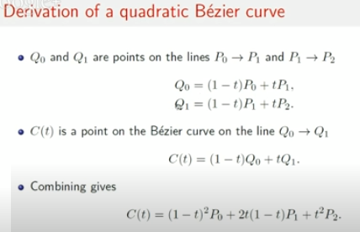
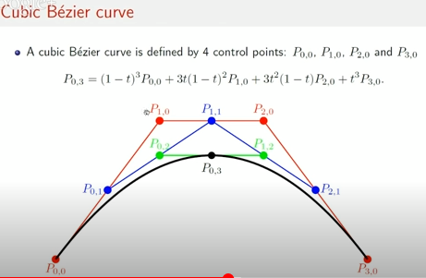

Slide 39
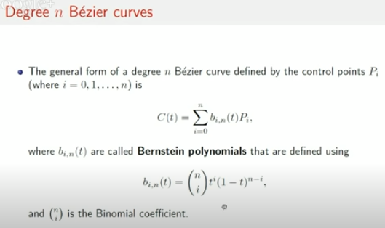
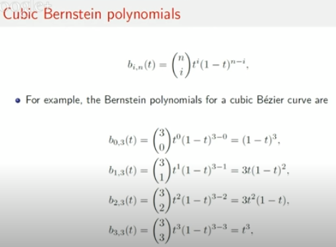
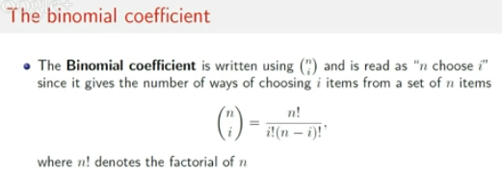

Slide 40
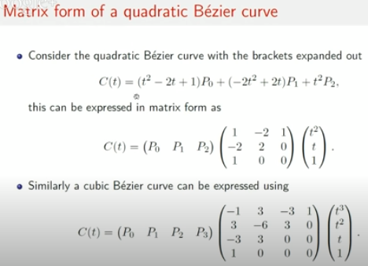

Slide 41
Properties of Bezier Curves
They generally follow the shape of the control polygon, which consists of the segments joining the control points.
They always pass through the first and last control points.
They are contained in the convex hull of their defining control points.
The degree of the polynomial defining the curve segment is one less that the number of defining polygon point. Therefore, for 4 control points, the degree of the polynomial is 3, i.e. cubic polynomial.
A Bezier curve generally follows the shape of the defining polygon.
The direction of the tangent vector at the end points is same as that of the vector determined by first and last segments.
The convex hull property for a Bezier curve ensures that the polynomial smoothly follows the control points.
No straight line intersects a Bezier curve more times than it intersects its control polygon.
They are invariant under an affine transformation.
Bezier curves exhibit global control means moving a control point alters the shape of the whole curve.
A given Bezier curve can be subdivided at a point t=t0 into two Bezier segments which join together at the point corresponding to the parameter value t=t0.

Slide 42
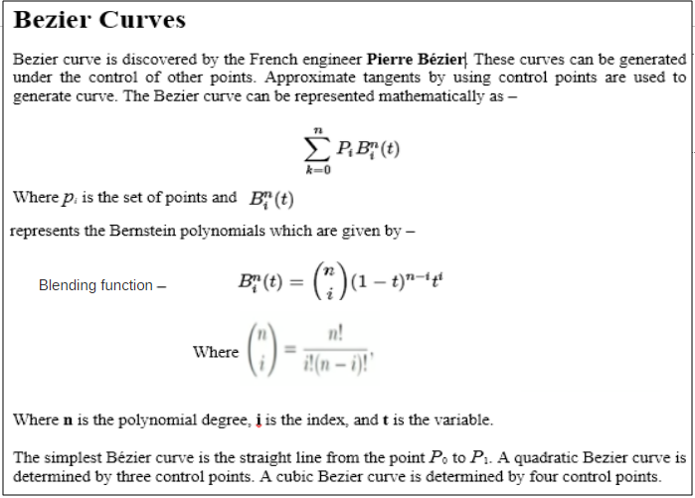
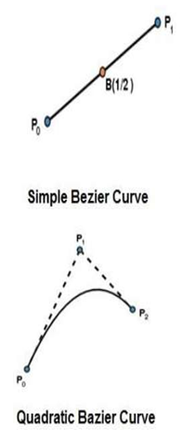
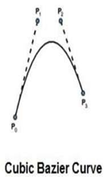

Slide 43
BEZIER CURVE EXAMPLE
Refer the BEZIER CURVE - PDF
(separately uploaded in LMS)

Slide 44
Applications of Bezier Curves
1. Computer Graphics
Bezier curves are widely used in computer graphics to model smooth curves.
The curve is completely contained in the convex hull of its control points.
So, the points can be graphically displayed & used to manipulate the curve intuitively.
2. Animation
Bezier curves are used to outline movement in animation applications such as Adobe Flash and synfig.
Users outline the wanted path in bezier curves.
The application creates the needed frames for the object to move along the path.
For 3D animation, bezier curves are often used to define 3D paths as well as 2D curves.
3. Fonts
True type fonts use composite bezier curves composed of quadratic bezier curves.
Modern imaging systems like postscript, asymptote etc use composite bezier curves composed of cubic bezier curves for drawing curved shapes.

Slide 45
Spline Representations
A spline is a smooth curve defined mathematically using a set of constraints.
Splines have many uses:
2D illustration
Fonts
3D Modelling
Animation

Slide 46
Interpolation Vs Approximation
A spline curve is specified using a set of control points. There are two ways to fit a curve to these points:
Interpolation - the curve passes through all of the control points
Approximation - the curve does not pass through all of the control points

Slide 47
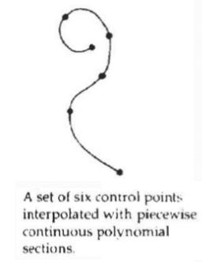
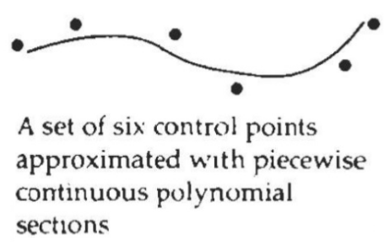
Interpolation
“Polynomial sections are fitted so that the curve passes through each control point, Resulting curve is said to interpolate the set of control points.”
Interpolation curves are commonly used to digitize drawings or to specify animation paths.
Approximation:
“The polynomials are fitted to the general control-point path without necessarily passing through any control point, the resulting curve is said to approximate the set of control points.” Approximation curves are primarily used as design tools to structure object surfaces
Approximation spline surface created for a design application. Straight lines connect the control-point positions above the surface.

Slide 48
B-Spline Curves
The Bezier-curve produced by the Bernstein basis function has limited flexibility.
First, the number of specified polygon vertices fixes the order of the resulting polynomial which defines the curve.
The second limiting characteristic is that the value of the blending function is nonzero for all parameter values over the entire curve.
The B-spline basis contains the Bernstein basis as the special case. The B-spline basis is non-global. A B-spline curve is defined as a linear combination of control points Pi and B-spline basis function Ni, k (t) given by,

Slide 49
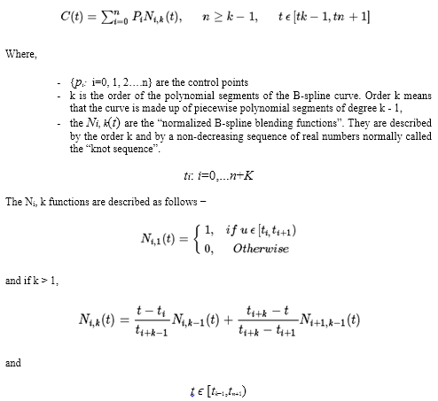
B-Spline Curves

Slide 50
Properties of B-spline Curve
The sum of the B-spline basis functions for any parameter value is 1.
Each basis function is positive or zero for all parameter values.
Each basis function has precisely one maximum value, except for k=1.
The maximum order of the curve is equal to the number of vertices of defining polygon.
The degree of B-spline polynomial is independent on the number of vertices of defining polygon.
B-spline allows the local control over the curve surface because each vertex affects the shape of a curve only over a range of parameter values where its associated basis function is nonzero.
The curve exhibits the variation diminishing property.
The curve generally follows the shape of defining polygon.
Any affine transformation can be applied to the curve by applying it to the vertices of defining polygon.
The curve line within the convex hull of its defining polygon.

Slide 51
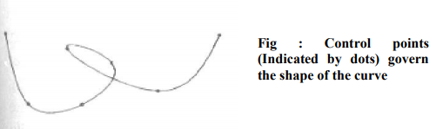
Shape description requirements
The following are some of the important properties that are used to design the curves.
Control Points: The shape of the curve can be controlled easily with the help of a set of control points, means the points will be marked first and curve will be drawn that intersects each of these points one by one in a particular sequence. The more number of control points makes the curve smoother. The following figure shows the curve with control points.

Slide 52
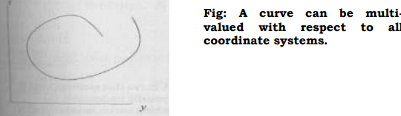
Shape description requirements
2. Multiple values: In general any curve is not a graph of single valued function of a coordinate, irrespective the choice of coordinate system. Generally single valued functions of a coordinate make the curves or graphs that are dependent on axis. The following figure shows multivalued curve with respect to all coordinate systems.

Slide 53
Shape description requirements
Axis independence: The shape of an object should not change when the control points are measured in different coordinate systems, that means when an object is rotated to certain angle in any direction (clockwise or anti-clockwise) the shape of the curve should not be affected.
Global or local control: The control points of a curve must be controlled globally from any function of the same program or it can also be controlled locally by the particular function used to design that curve by calculating the desired control points.
Variation-diminishing property: Some of the mathematical functions may diminish the curve at particular points and in some other points it may amplify the points. This leads to certain problems for curves appearance at the time of animations, (just as a vehicle looks curved when it is taking turn). This effect must be avoided with the selection of proper mathematical equations with multiple valued functions.
Versatility: The functions that define the shape of the curve should not be limited to only few varieties of shapes, instead they must provide vide varieties for the designers to make the curves according to their interest.
Order of continuity: For any complex shapes or curves or surfaces it is essential to maintain continuity in calculating control points. When we are not maintaining the proper continuity of control points it makes a mesh while marking the curve and the complex object.

Slide 54
Parametric functions
In mathematics, a parametric equation defines a group of quantities as functions of one or more independent variables called parameters. Parameterizations are non-unique; more than one set of parametric equations can specify the same curve.
The dominant form used to model curves and surfaces is the parametric or vector valued function. A point on a curve is represented as a vector: P(u)=[x(u) y(u) z(u)].
For surfaces, two parametric are required: P(u, v)=[(x(u, v) y(u, v) z(u, v)].
As the parametric u and v take on values in a specified range, usually 0 to 1, the parametric functions x, y and z trace out the location of the curve or surface. The parametric functions can themselves take many forms. A single curve be approximated in sever different ways as given below:
P(u) = [cos u sin u]
P(u) = [(1 – u²)/(1 + u²) 2u/(1 + u²)]
P(u) = [u (1 – u²) ^{1/2}]
By using simple parametric functions, we cannot expect the designer to achieve a desirable curve by changing coefficients of parametric polynomial functions or of any other functional form. Instead we must find ways to determine the parametric function from the location of control points that are manipulated by the designer.

Slide 55
References
https://en.wikipedia.org/wiki/Gallery_of_curves

